Slide 1
Analyzing Reddit Comments on Palestine and Israel CONFLICT
ALEENA BINOY
ARCHANA VIJAYAN
SHARAN SARA SHAJI
MANIKANTAN SREEKUMAR
ANOOP JAYAPRAKASH
DEEPESH DINESH KUMAR

Slide 2
CONTENT
INTRODUCTION
PROBLEM
SOLUTION
DATA COLLECTION
DATAPROCESSING
SMOTE
FEATURE ENGINEERING
MODEL BUILDING AND EVALUATION
MODEL DEPLOYEMET
MODEL INTERPRETABILITY

Slide 3


INTRODUCTION

Slide 4
Business Domain
sentiment analysis of Reddit comments, particularly discussing about the Palestine-Israel conflict.
could be relevant to industries or organizations involved in conflict resolution, international relations, social media analysis, or sentiment monitoring

Slide 5
Problem statement
To classify Reddit comments into relevant categories or sentiments, such as those expressing support for Palestine, support for Israel, neutral opinions, or inflammatory language.
we’re dealing with the challenge of distinguishing between comments likely to be upvoted and those likely to be downvoted on Reddit.

Slide 6
SOLUTION
To tackle this problem, We propose building a machine learning model using the Random Forest algorithm.
The goal is to classify Reddit comments and predict whether they are likely to receive upvotes or downvotes.
By analyzing features such as comment content, sentiment, and context, the model can make informed predictions.

Slide 7
DATA COLECTION
Dataset is collected from kaggle features :
comment_id: Unique identifier for each comment
score: The score (upvotes - downvotes) received by the comment
self_text: The text content of the comment
subreddit: The subreddit where the comment was posted
created_time: Timestamp of comment creation

Slide 8
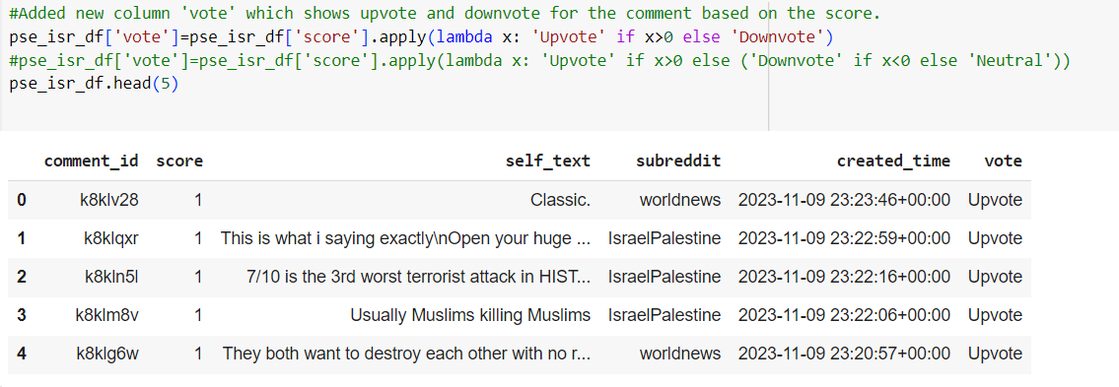
Data Preprocessing
the handling of missing values in the dataset.
new column called 'vote' to the DataFrame based on the 'score' column. If the score is greater than 0, it assigns 'Upvote', otherwise 'Downvote'.

Slide 9
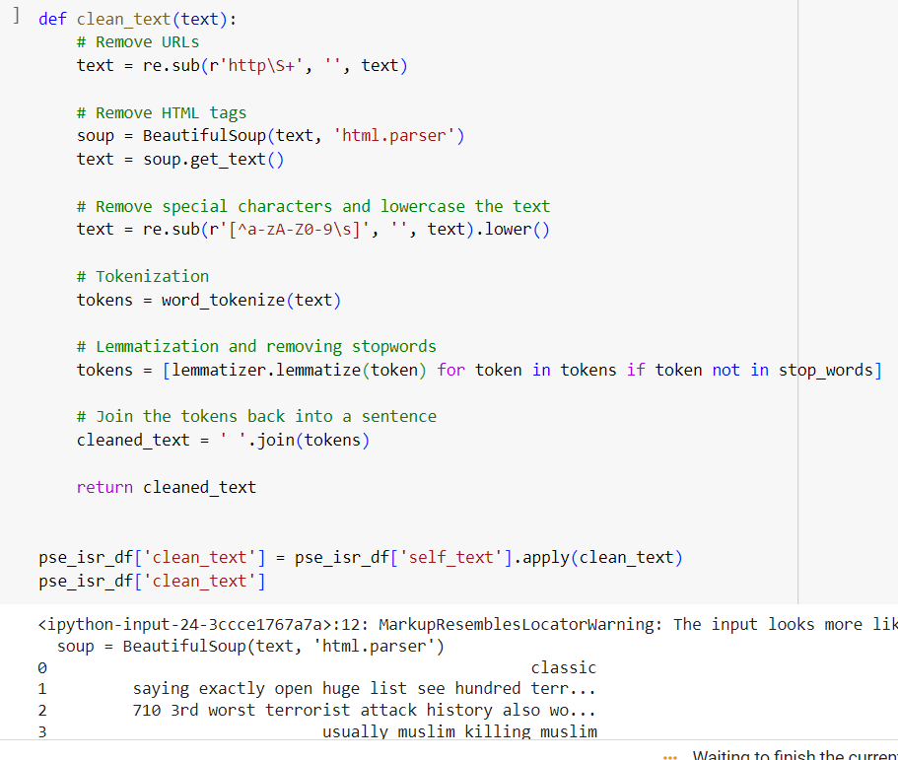
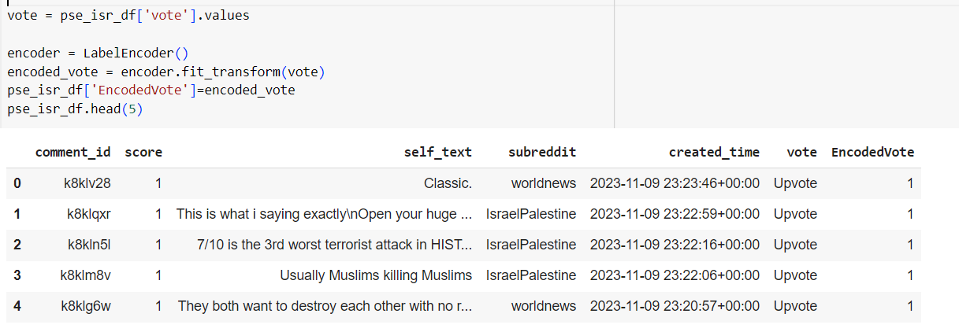
encoding the 'vote' labels into numerical values using LabelEncoder
Clean text data by removing URLs, HTML tags, special characters, and stopwords, then tokenize and lemmatize the text using NLTK and BeautifulSoup.

Slide 10
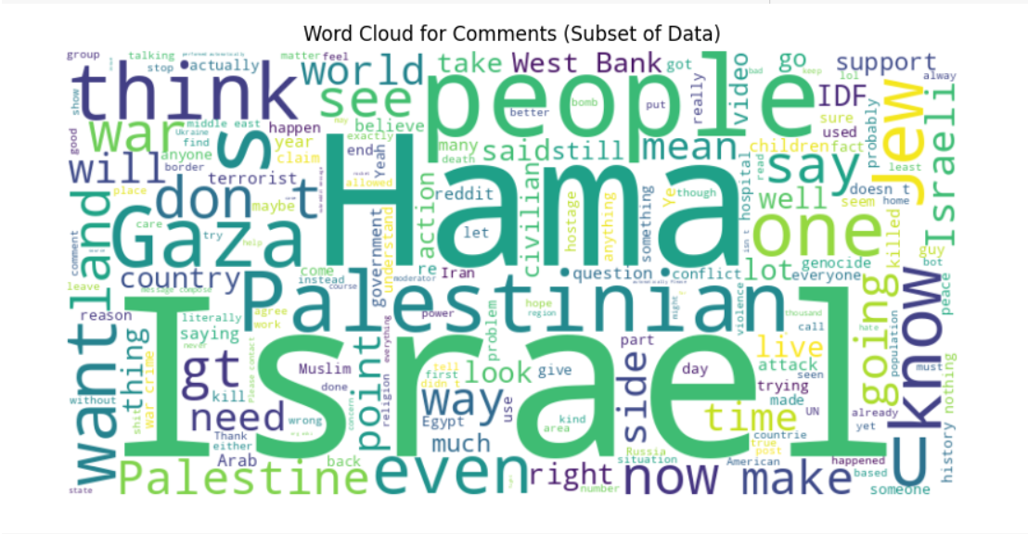
Feature engineering
a quick overview of the most frequent words in the comments, which can help in understanding the data and identifying common themes or topics.

Slide 11
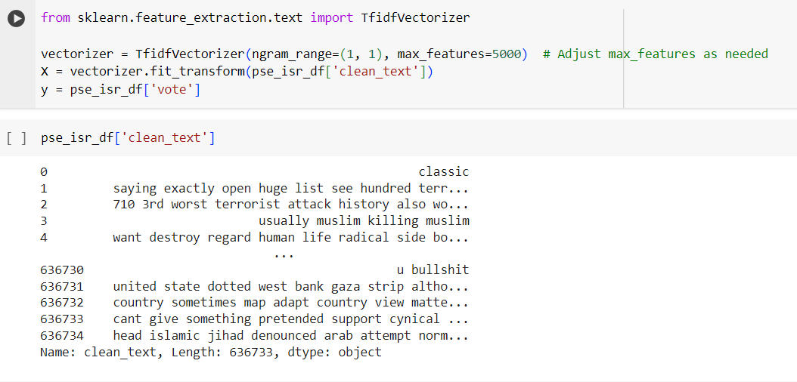
Transforms text data into numerical features based on term frequency-inverse document frequency (TF-IDF) ,prepare target labels for sentiment analysis..

Slide 12
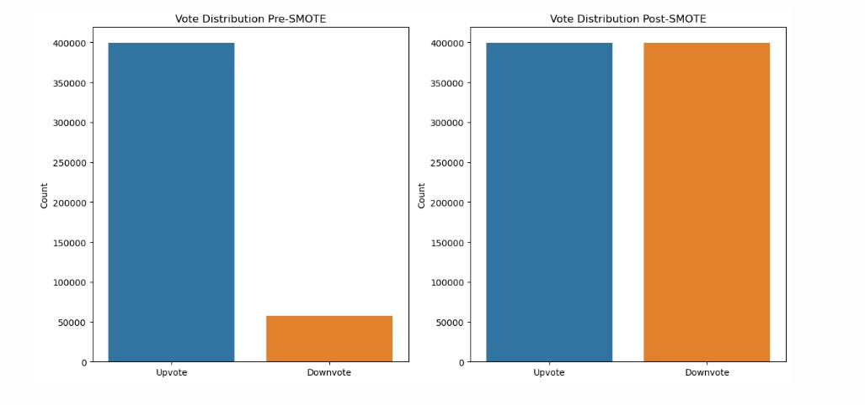
smote
Visualize the distribution of upvotes and downvotes before and after applying SMOTE (Synthetic Minority Over-sampling Technique) for class imbalance correction using seaborn library in Python, highlighting the equalization of class distribution post-SMOTE.

Slide 13
Model building
Model Training:
The code snippet trains a RandomForestClassifier using the imbalanced data after applying SMOTE (Synthetic Minority Over-sampling Technique) to balance the dataset. It initializes the classifier with certain hyperparameters like the number of estimators, minimum samples split, minimum samples leaf, and sets the number of jobs to run in parallel.
The RandomForestClassifier is trained on the resampled training data (X_train_sm and y_train_sm) obtained after applying SMOTE.

Slide 14
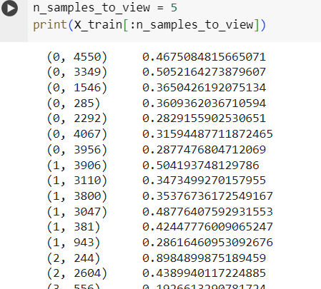
Making Predictions:
Once the model is trained, the code uses it to make predictions on the test data (X_test). It calls the predict method of the trained classifier (clf) to generate predictions for the test data.
The output snippet shows the sparse representation of the TF-IDF matrix for some sample data points, where each row represents a document and each column represents a unique word feature.

Slide 15
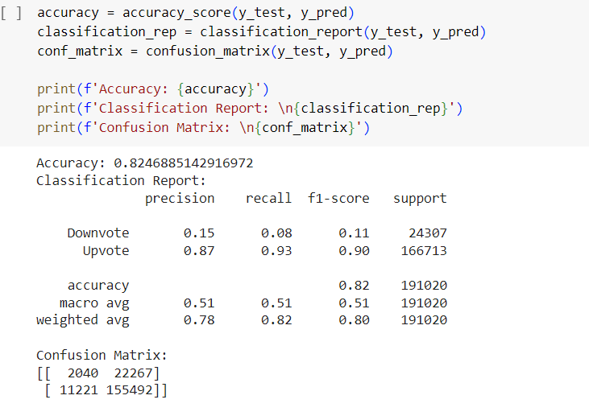
Model evaluation
Achieved an accuracy of 84.77%, with precision, recall, and F1-score of 0.87, 0.96, and 0.92 respectively for the 'Upvote' class.
However, performance for the 'Downvote' class is notably lower, with precision, recall, and F1-score of 0.16, 0.05, and 0.07 respectively.
The confusion matrix illustrates 1138 correct predictions for 'Downvote' and 160789 correct predictions for 'Upvote', but also reveals 23169 false 'Downvote' predictions and 5924 false 'Upvote' predictions.

Slide 16
Model Interpretability:
Created a LIME (Local Interpretable Model-agnostic Explanations) explainer for tabular data, specifically designed for a regression task.
Utilized a sparse matrix representation of the training data (X_train) to initialize the explainer, specifying the target variable ('MEDV') as the class name.
Set verbose=True for detailed output during explanation generation and disabled discretization of continuous features (discretize_continuous=False) to maintain the integrity of sparse data.

Slide 17
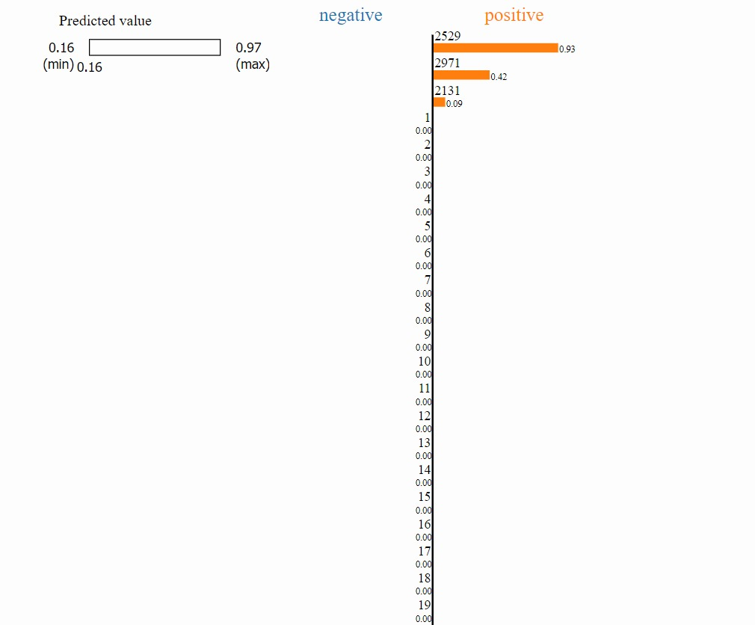
The intercept of the local model is 0.8627, and the local prediction is 0.8971, indicating a positive prediction.
The actual value (right) for this instance is 0.1594.
Utilized LIME to generate local interpretable explanations, highlighting the most influential features contributing to the model's prediction.
Displayed the explanation in a notebook, focusing on the top features.

Slide 18
Model deployement
Saved the trained classifier model and the TF-IDF vectorizer using the joblib library for later use.
This allows for easy loading and reuse of the models without needing to retrain them each time.

Slide 19
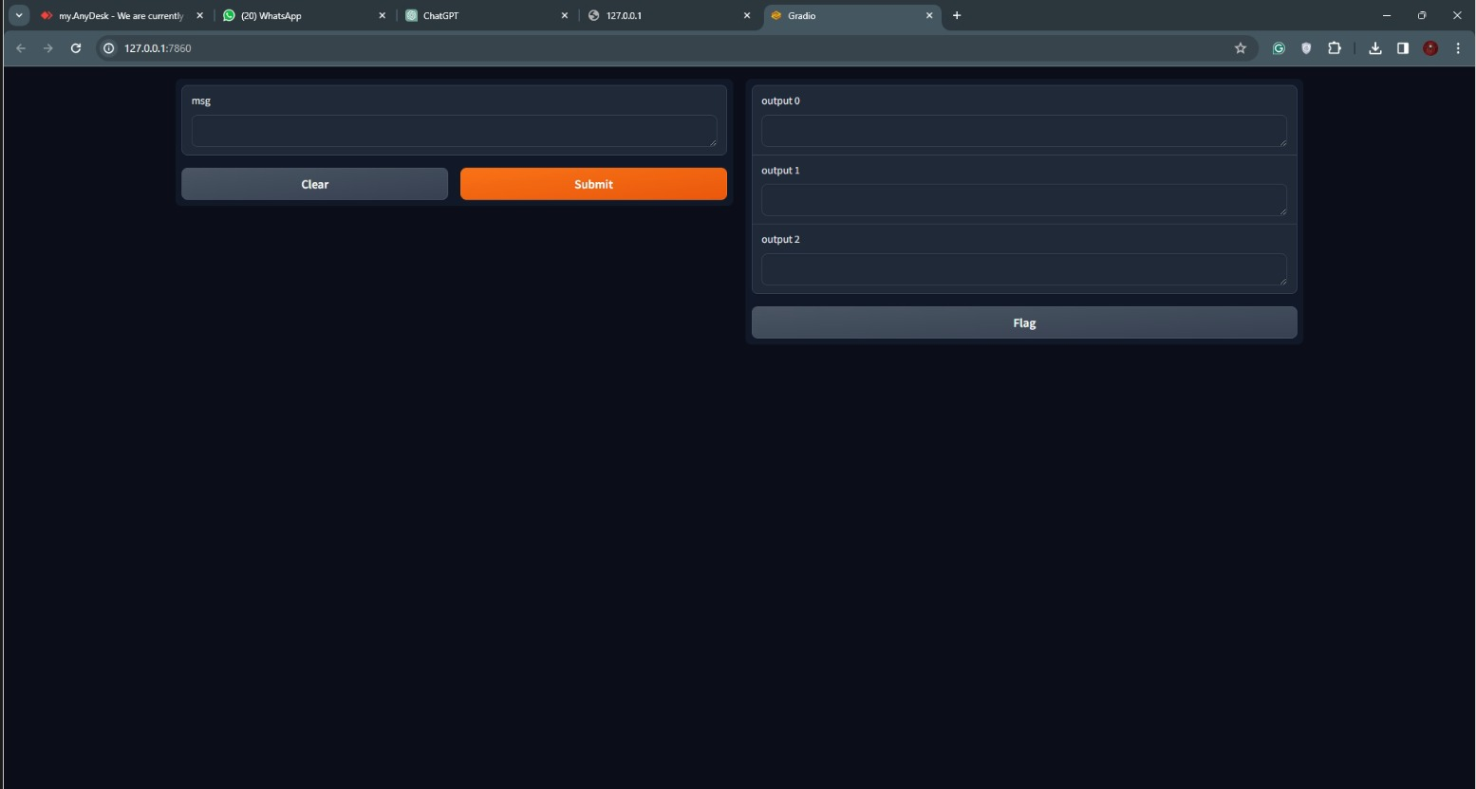
demo

Slide 20
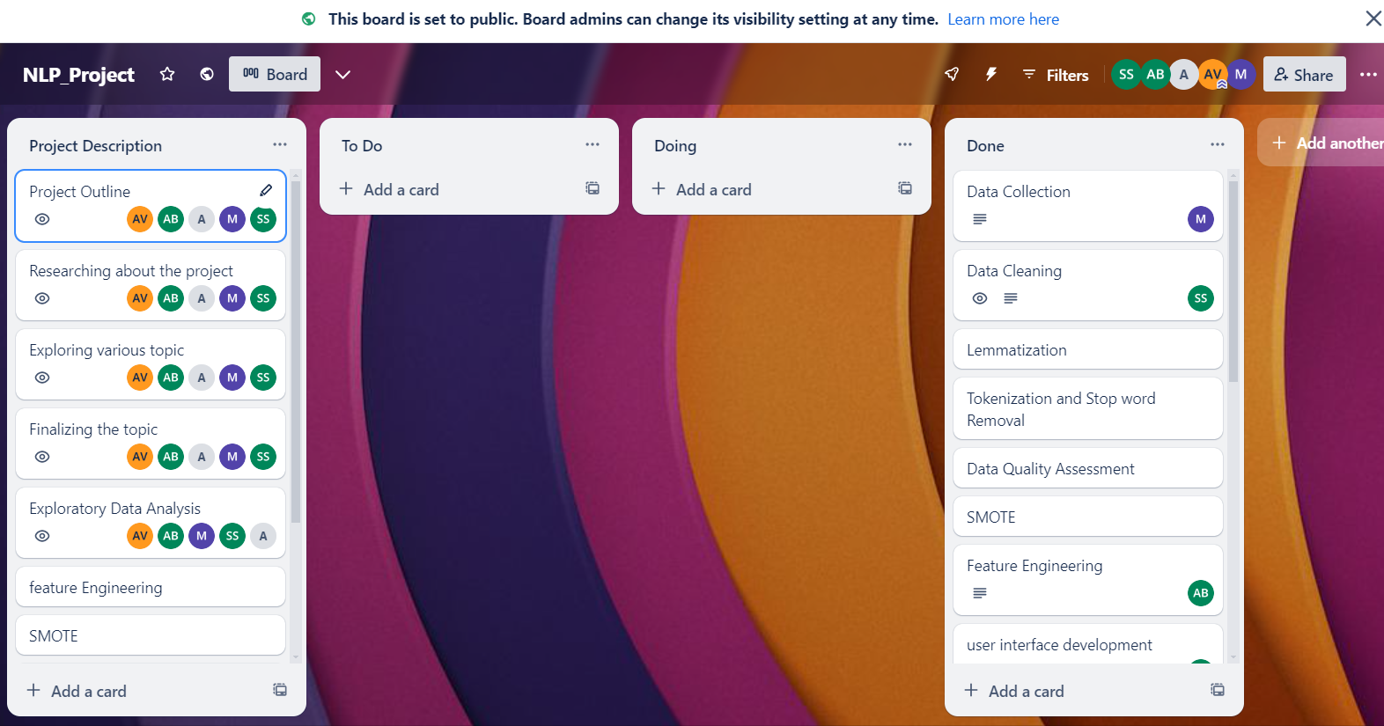
TRELLO BOARD
https://trello.com/b/WBr926Jt/aiproject

Slide 21
Thank you

